Slide 1
OPTICS
Renato R. Maaliw III, DIT
College of Engineering
Southern Luzon State University
Lucban, Quezon, Philippines

Slide 2
Ordering Points To Identify the Clustering Structure
is a density-based clustering algorithm that is an extension of DBSCAN
designed to address some of the limitations of DBSCAN by providing a richer and more robust view of the data’s cluster structure

Slide 3
Core Concept
it does not explicitly produce a clustering like DBSCAN, it creates an augmented ordering of database representing its density-based structure

Slide 4
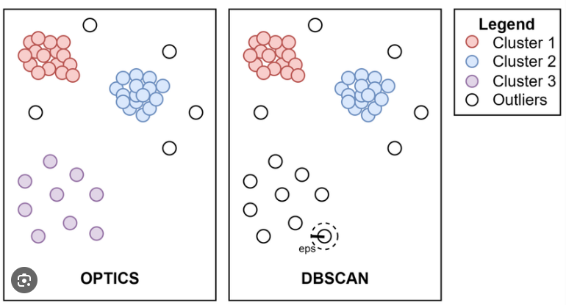

Slide 5
OPTICS is ideal for:
Datasets with varying density clusters
Understanding hierarchical density-based structures
Applications where DBSCAN would struggle due to a single global epsilon value

Slide 6
Core Components:
Core Distance: Minimum radius required to include at least minPts neighbors around a point
Reachability Distance: Distance between two points p and q defined as:
Ordering: OPTICS builds an ordering of data points based on their reachability distances which allows for easier visualization and cluster extraction

Slide 7
Key Differences Between OPTICS and Others

Slide 8
🔹 vs. DBSCAN
OPTICS avoids the need for a global epsilon by building a reachability plot.
Better for datasets with clusters of varying density.
DBSCAN gives a hard clustering; OPTICS gives a cluster ordering that can be used flexibly.

Slide 9
🔹 vs. KMeans
KMeans assumes spherical clusters and requires specifying k.
OPTICS detects arbitrary shapes and automatically infers the number of clusters.
KMeans is distance-based, while OPTICS is density-based.

Slide 10
🔹 vs. Hierarchical Clustering
Hierarchical methods build a dendrogram but don’t consider density.
OPTICS provides density-aware hierarchical structures.
Hierarchical methods are greedy, while OPTICS is more global in approach.

Slide 11
🔹 vs. Gaussian Mixture Models
GMM assumes data is generated from a mixture of Gaussians.
OPTICS is non-parametric and makes no assumptions about distribution.
GMM fails with non-Gaussian, irregularly shaped clusters.

Slide 12
🔹 vs. Spectral Clustering
Spectral clustering relies on the eigenvalues of a similarity matrix, which is computationally expensive.
Spectral clustering works well for complex boundaries, but doesn’t handle density variation or noise well.
OPTICS is more robust to noise and density fluctuations.

Slide 13
Thank you very much for listening.

